Slide 1
Intro to Programming
Class 2: Let’s get moving!
November 2021
Emily Gelfand
Emily Joyce

Slide 2

Disclaimer
I will be running through the basics, and potentially skipping some depending on time. This is meant to be an intro/overview, so absorb what you can now and go back over this later on your own time if you think you need to nail it down further. Don’t worry if it feels like a lot – it is!

Slide 3


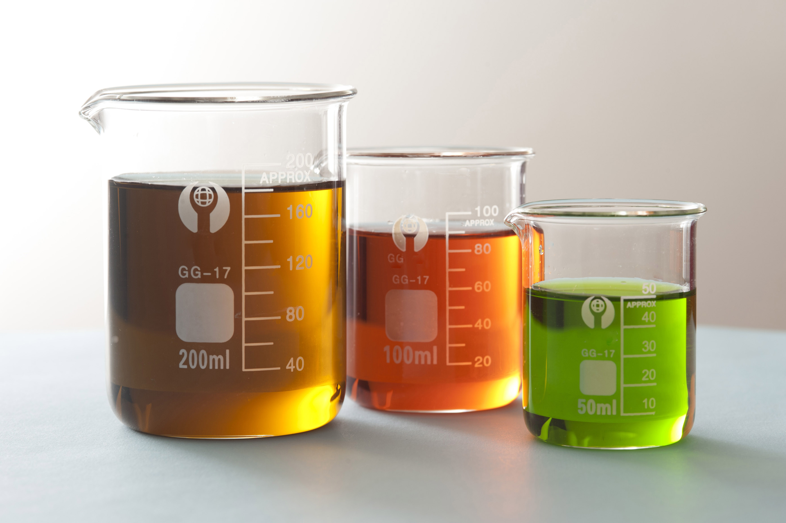
STORY TIME!
Last week your lab ran the same experiment twice on different days, all using (what they thought) were samples from the same batch. Each experiment should have generated 5 good pieces of data.
However, when the results came in, your team realized that both experiments turned out totally differently! Some of the resulting data was junk, and other parts were perfectly fine, and no one is sure of precisely what was different.
You’ve been asked to investigate the experiment data for a potential cause for your upcoming data review meeting – can you find the answer?
First, let’s find out what tools we can use to solve this mystery!
Notes:
This is a real problem I’ve solved just recently for our lab, but I felt like it was generalizable enough that I’ve experienced it in just about every other lab I’ve worked at or with. So, here’s the story: …
As you can see, there’s lots of things that could be the cause here, or could potentially be irrelevant. What does the prompt suggest might be the problem before you even see the data, knowing nothing about the experiment? Rather than doing what people without skills to manipulate data can do, let’s learn how we can find the answer.

Slide 4
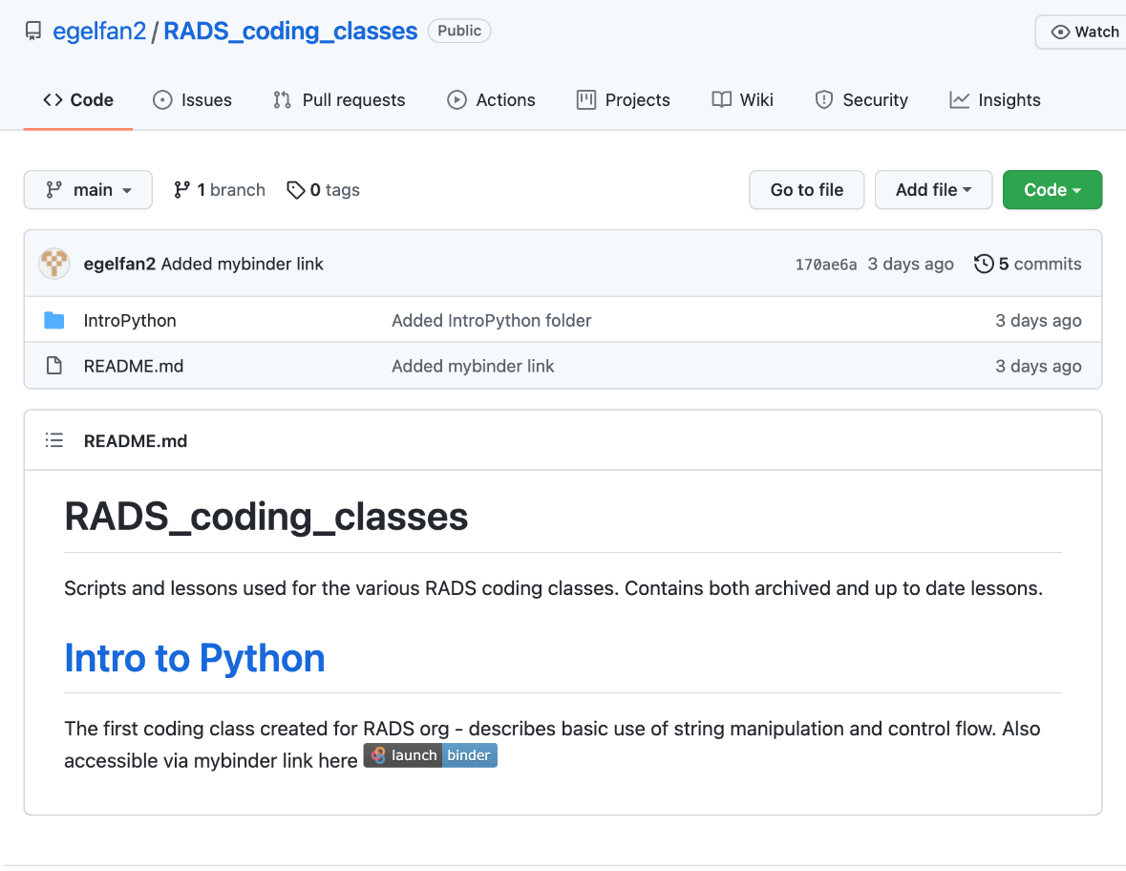
Getting started
We are going to skip installing python for this class and instead practice coding in our browsers.
Go to https://github.com/egelfan2/RADS_coding_classes in your browser
Click on launch | binder

Slide 5
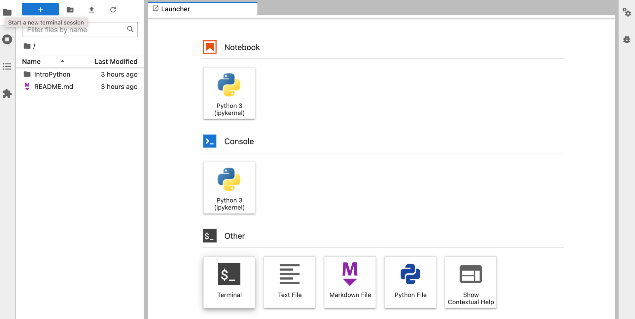
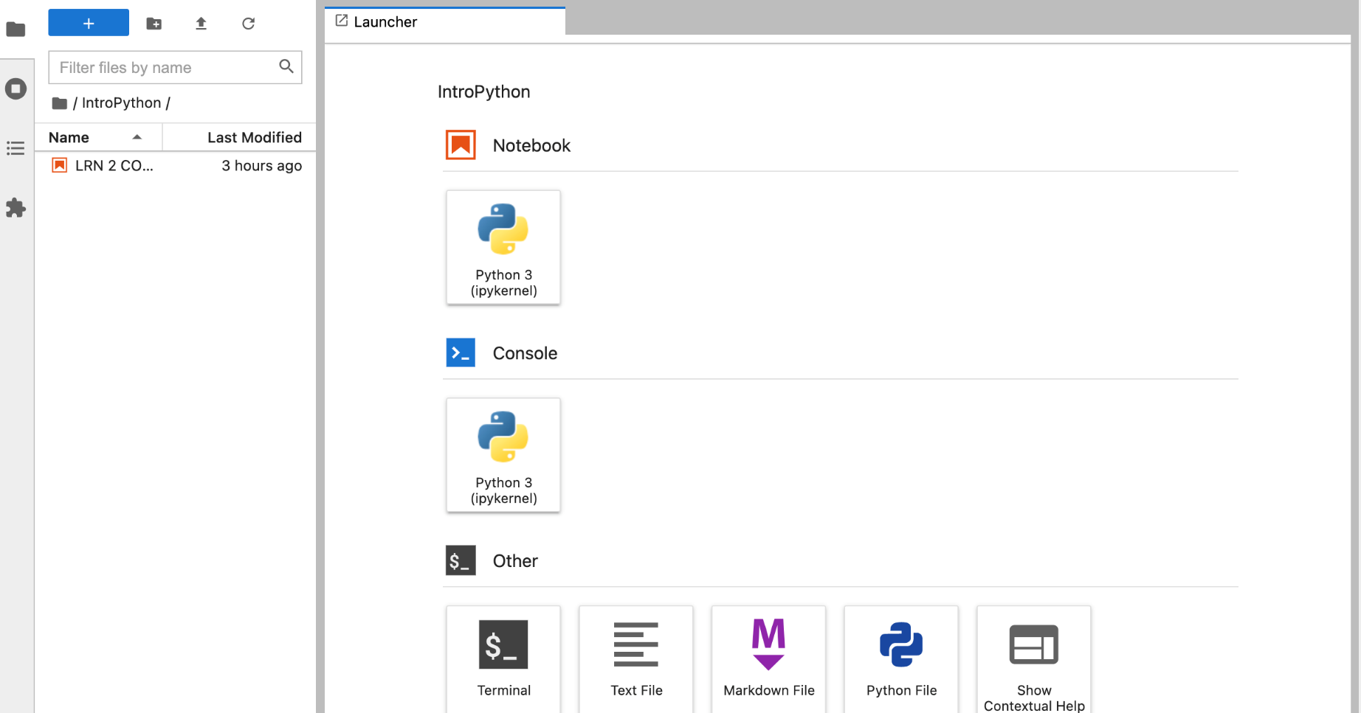
Getting started
Click the IntroPython folder
Click on LRN_@_CODE_2 to open the jupyter notebook file for today

Slide 6
Summary
Quick types/variables summary from last lesson
Notes:
Going to quickly refresh your memories on some of the things we touched on last time that we’ll actually start using this time.

Slide 7
Types cheatsheet
Name | Type | Description
Integer | int | Whole numbers, such as: 3 300 200
Floating point | float | Numbers with a decimal point: 2.3 41.6 507.912
String | str | Ordered sequence of characters: ‘hello world’ ‘Jack123’ “200” “馬 / 马”
List | list | Ordered sequence of separate objects: [15, “dog”, “200”]
Dictionary | dict | Unordered key:value pairs: {“key here” : “value here”, “name” : “Emily”, “workplace”: “Allen Institute”
Set | set | Unordered collection of unique objects: {‘a’, ‘b’, ‘c’}
Boolean | bool | Logical value indicating True or False

Slide 8
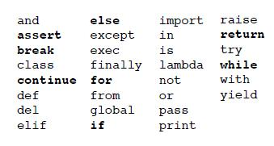
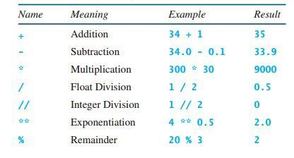
Keywords and Operators
Sometimes, you want to leave a note to yourself (or others) in your code. This is called a comment. Do it more often than you think is necessary! You will definitely *not* remember what you were thinking by tomorrow!
The comment “operator”, or special character that implies mathematical or logical operations, is # - Anything following the # will be ignored by your code (operators work like the “keywords” we mentioned earlier).
For reference, Here’s a short list of keywords (left) and operators (right) so you know what to avoid:
Notes:
Is there anything else anyone needs us to go over before we test your skills?

Slide 9

General tools
Let’s move into our notebooks we just opened to finally make something go!
We’ll be switching back and forth a bit for the next part so keep it handy!

Slide 10

Variables
Regardless of which data type you’re using, at some point, you’ll want your code to actually do something (don’t we all). In order to run anything, what you’ll have to do is store information in what’s called a variable, or a way of telling your computer what data to store.
Variables can be named whatever you want, but beware of falling into a few classic traps:
Python (and most other languages) have something called “Keywords”, or words that can’t be used as variable names, function names, or other identifiers, as they’re used to define the structure of the language itself (more on that later)
If you name a variable a single letter when writing code someone else might ever have to look at, you’re going straight to heck.
Notes:
Just like in math! Jupyter notebooks it’ll change color (keywords).

Slide 11
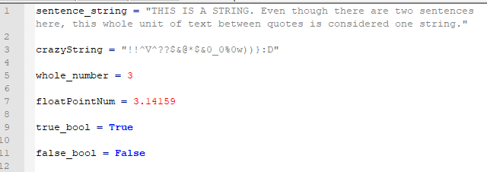
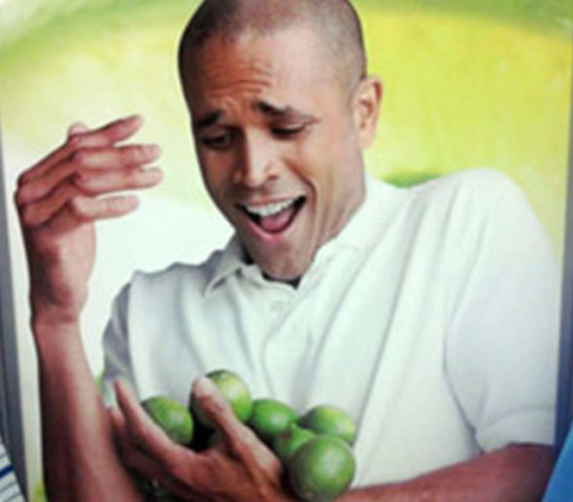
How can I hold all this information?
The previous data types we talked about, stored as variables. Python is a flexible language, which means that it doesn’t make you tell it what data type each variable will be – you just store the variable*
*When writing more complex code in python, such as a larger program or a program that might be used or read by multiple people, it’s considered best practices to declare what “type” you intend a variable to be. This makes the code easier to read and easier to debug. However, when writing one-off scripts, it’s not as critical to do.
Notes:
Equals sign is assignment.

Slide 12
Keywords and Operators
Sometimes, you want to leave a note to yourself (or others) in your code. This is called a comment. Do it more often than you think is necessary! You will definitely *not* remember what you were thinking by tomorrow!
The comment “operator”, or special character that implies mathematical or logical operations, is # - Anything following the # will be ignored by your code (operators work like the “keywords” we mentioned earlier).
For reference, Here’s a short list of keywords (left) and operators (right) so you know what to avoid:

Slide 13
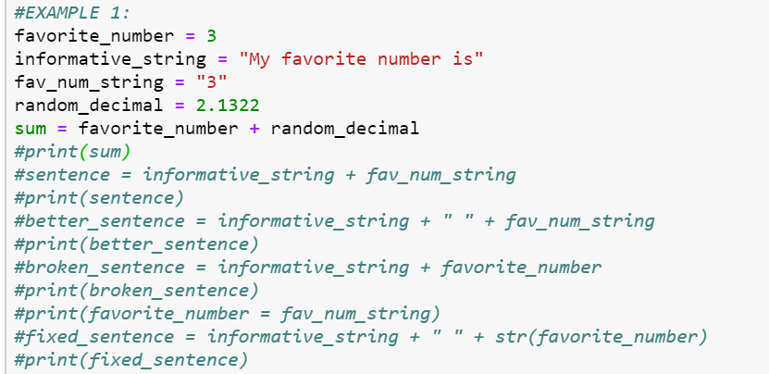
Data Types Matter!
Example 1:

Slide 14
How can you tell what types you’re using?
Type command:
Type(variable_name) gives you the “type” of variable_name, (i.e. “int” or “string”)
Very useful to check if you’re seeing a TypeError – that usually means that you’ve accidentally/unknowingly changed the variable type without realizing!
The ever critical Print command:
Print() does what it says on the box – shows you the contents of whatever you’re asking to print! It can be a variable name, a command, text, anything.
Critical for basically everything you want to do – otherwise you won’t see what’s going on in there! The only thing you’ll need to keep in mind is that the types need to match- if you try to print(‘string’ + 7) you’ll get an error, whereas print(‘string’+’7’) will give you ‘string7’

Slide 15
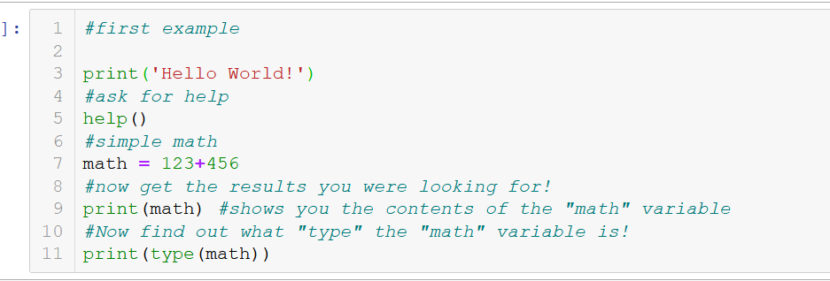
Example 2: basics
This one’s in your notebook so you can follow along!

Slide 16
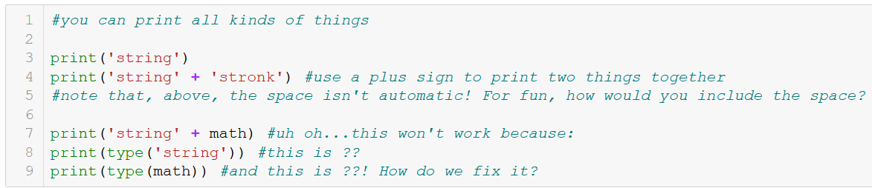
Example 3: printing
This is cell 2 in your notebooks – try it out!

Slide 17
Practice!
Solve and save the result of 23 * 71 as a variable
Now solve and save the result of 6 to the power of 3 as another, differently named variable
Finally, check if the second result is greater than the first result and print the final answer!
Notes:
Show us what you got! Go to your notebooks and try solving these problems. You’ll have the answer sheet available, but don’t use it unless you really feel stuck and neither Emily nor I can help you. Notice that your answer was a boolean!

Slide 18
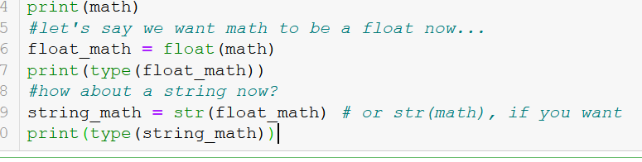
Casting (no not spells)
Want to change the type of whatever you’ve written? Use casting!
You can cast most things to most types, but below (and in your notebooks) we’re just giving you a few examples.

Slide 19
Some more math
Math stuff: +, -, /, *, %, >, <, ==
PEMDAS is not automatic in python!

Slide 20
Quick builtins
Max()
Min()
Len()

Slide 21
PRACTICE # 2
In the “Practice #2” cell in the jupyter notebook you got, you’ll see a string containing some messy animal data.
Find where the second animal ID starts.
Split the string into two strings, one for each animal's data (each string should contain one animal ID, one project name, one genotype, and one barcode)
Replace the project name with the phrase “Mindscope“, and then Join the two strings back together, separated by a hyphen.
Notes:
Split, find, replace, join. Ask us any questions you might have – this one’s harder than the last! We’re here to help!!

Slide 22

Control flow
Now that we’re getting stronger, let’s talk more complex logic!

Slide 23
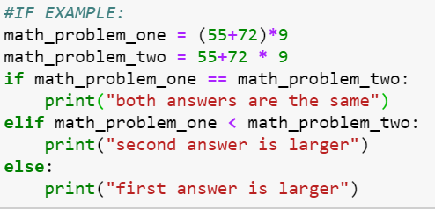
If statements
Let’s say you want your code to make a choice, depending on the result of a calculation. This is called a “conditional” statement, where code is executed based on a condition. Operators can be used here, such as >, <, or == as well as keywords OR or AND.
The key phrases to use here are if followed by else. Optionally, if there’s more than one condition, you can also use the keyword elif in between, which allows you to add conditional statements.
Example:
Notes:
Why two equals signs? If you’ve noticed, we’ve used one equals sign to indicate that we’re setting a variable equal to something. Two equals signs is a test for equality, rather than an assignment of a value.
TASK: change the operations in the math problems to get the first result to print. Now can you make it print the second?

Slide 24
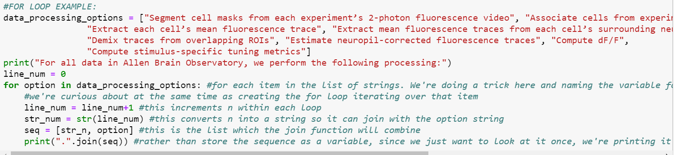
For Loops
Sometimes you’ll need your code to do the same thing multiple times, and store the results. For this, we use a for loop, which will repeat the contained code block until the defined stop condition is met.
Example:
Notes:
TASK: remove the second and fourth items in the list and reprint the for loop – does the numbering change? Now add a silly item somewhere in the list and print the for loop again.

Slide 25
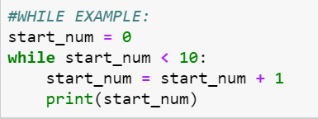
While Loops
Sometimes you need your code to keep running for a long time until a certain condition (called a “stop” condition) is met. Unlike for loops, the number of times a while loop will run is not set ahead of time, and sometimes not always known! A common error mode when using while loops is not setting a valid stop condition, which leads to it running forever, and eventually crashing once its used up all of your computer memory. Remember to always check what you’re running, and to check your stop conditions!
Example:
Notes:
TASK: What happens if we remove the line that adds 1 to the start num? This is where we learn about the “stop” button!
Change the operation on the start num so it prints only odd numbers. Any other questions before our final practice?

Slide 26
PRACTICE 3
Now we’re ready to rock our upcoming meeting and solve the mystery of the two “identical” experiments with different results!
In your notebooks, under practice 3, you’ll find information from both experiments. Search the data for clues using the tools we just learned how to use, and find the culprit!
There are many valid ways you can solve this problem. If you get stuck, feel free to ask questions in the chat!

Slide 27

Wow, that was a lot!
No worries – all of this information takes time and practice to master. Even if the concepts themselves seem simple, there’s a lot to remember and keep track of.
Just keep practicing and you’ll DEFINITELY improve!

Slide 28
Thanks for coming!
Questions? Concerns? Suggestions? Need info?
!RADS_ORG
Python documentation: https://docs.python.org/3/
Contains a handy tutorial and links to documentation for previous versions of python.

Slide 29
THANK YOU
We wish to thank the Allen Institute for Brain Science founder,
Paul G. Allen, for his vision, encouragement and support.

